Slide 1
Query Processing and Optimization

Slide 2
Need of Query Processing:
The main goal of creating a database is to store the related data at one place, access and manipulate them as and when it is required by the user.
Accessing and manipulating the data should be done efficiently i.e. it should be accessed easily and quickly.
This SQL is a high level language created to build a bridge between user and DBMS for their communication.
But the underlying systems in the DBMS will not understand SQL.
There has to be some low level language which these systems can understand.

Slide 3
Query Processing :
Refers to the range of activities involved in extracting data from a database.
The activities includes translation of queries in high level database language into expression that can be used at the physical level of the file system
Variety of query optimizing transformations are used.
Actual evaluation plan is created.

Slide 4
Query Processing would mean the entire process or activity which involves query translation into low level instructions, query optimization to save resources, cost estimation or evaluation of query, and extraction of data from the database.
Goal: To find an efficient Query Execution Plan for a given SQL query which would minimize the cost considerably, especially time.

Slide 5
Basic Steps in Query Processing
Query Processing is the activity performed in extracting data from the database.
In query processing, it takes various steps for fetching the data from the database. The steps involved are:
Steps involved in processing a query are:
1.Parsing and translation
2. Optimization
3. Evaluation

Slide 6
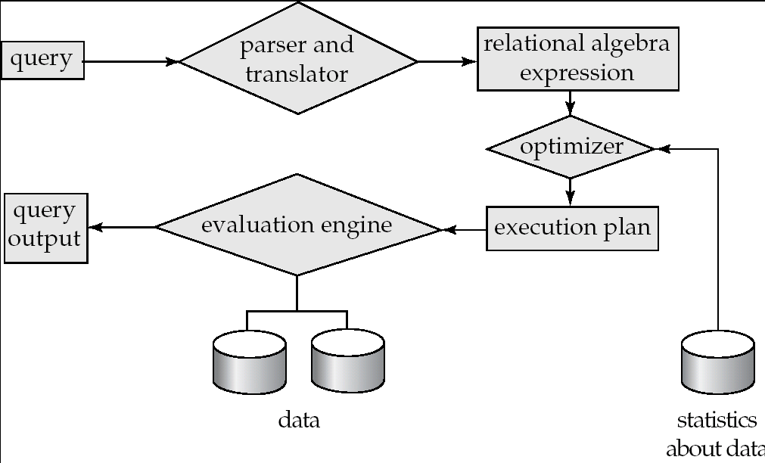
Basic Steps in Query Processing

Slide 7
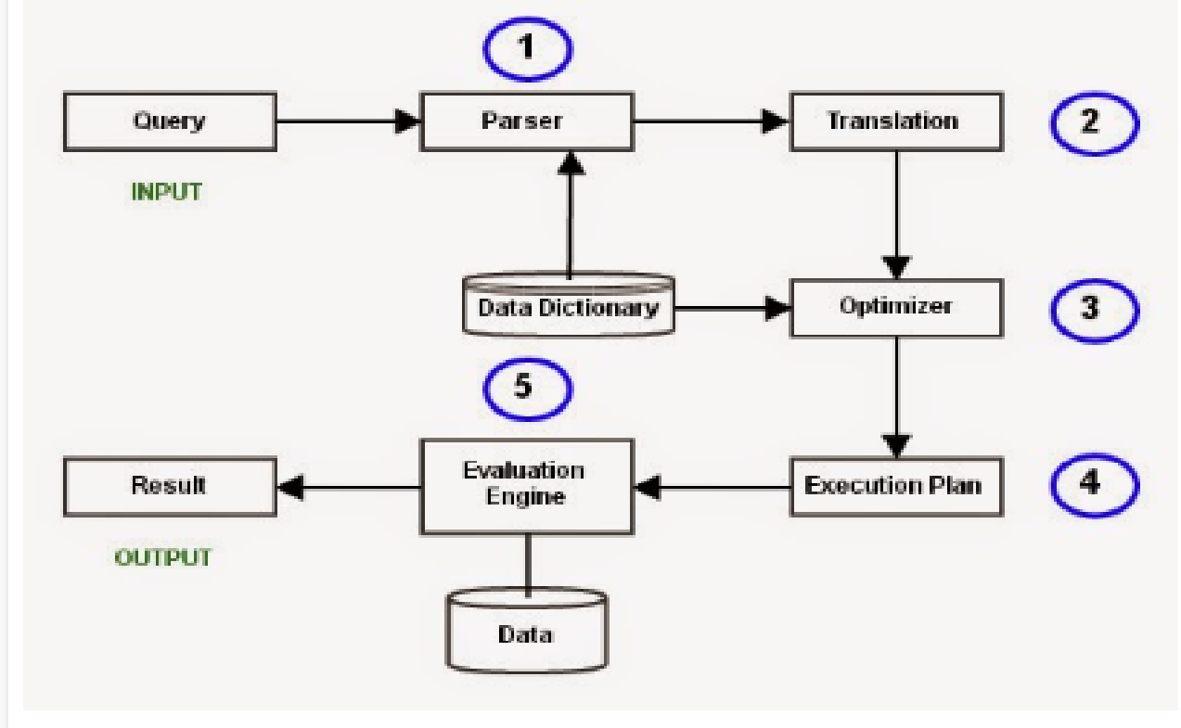
The major steps involved in query processing:

Slide 8
Parsing and Translation:
Parsing
This is the first step of any query processing.
The user typically writes request in SQL language.
In order to process and execute this request, DBMS has to convert it into low level – machine understandable language.
Any query issued to the database is first picked by query processor.
It scans and parses the query into individual tokens and examines for the correctness of query.
It checks for the validity of tables / views used and the syntax of the query.
In this step, the parser of the query processor module checks the syntax of the query, the user’s privileges to execute the query, the table names and attribute names, etc.
The correct table names, attribute names and the privilege of the users can be taken from the system catalog (data dictionary).

Slide 9
Translation
If we have written a valid query, then it is converted from high level language SQL to low level instruction in Relational Algebra.
Once it is passed, then it converts each tokens into relational algebra expressions , trees and graphs.
These are easily processed by the other parsers in the DBMS.

Slide 10
Suppose a user executes a query.
As we have learned that there are various methods of extracting the data from the database.
In SQL, a user wants to fetch the records of the employees whose salary is greater than or equal to 10000. For doing this, the following query is undertaken:
Employee(ssn,emp_name,salary,dno)
select emp_name from Employee where salary>10000;
Thus, to make the system understand the user query, it needs to be translated in the form of relational algebra.
We can bring this query in the relational algebra form as:
σsalary>10000 (πemp_name,salary (Employee))
πsalary (σsalary>10000 (Employee))
After translating the given query, we can execute each relational algebra operation by using different algorithms. So, in this way, a query processing begins its working.

Slide 11
Parsing and translation Process
Initially, the SQL query is scanned.
Then it is parsed to look for syntactical errors and correctness of data types.
If the query passes this step, the query is decomposed into smaller query blocks.
Each block is then translated to equivalent relational algebra expression.

Slide 12
1. Translating SQL Queries into Relational Algebra
Query block:
The basic unit that can be translated into the algebraic operators and optimized.
A query block contains a single SELECT-FROM-WHERE expression, as well as GROUP BY and HAVING clause if these are part of the block.
Nested queries within a query are identified as separate query blocks.
Aggregate operators in SQL must be included in the extended algebra.

Slide 13
Employee(Eno, Ename, Phone)
Proj_Assigned(Eno, Proj_No, Role, DOP)
SELECT Ename
FROM Employee, Proj_Assigned
WHERE Employee.Eno = Proj_Assigned.Eno AND DOP > 10;
πEname(σDOP>10 Λ Employee.Eno=Proj_Assigned.Eno(Employee X Prof_Assigned))

Slide 14
Translating SQL Queries into Relational Algebra (2)
SELECT LNAME, FNAME
FROM EMPLOYEE
WHERE SALARY > ( SELECT MAX (SALARY)
FROM EMPLOYEE
WHERE DNO = 5);
SELECT LNAME, FNAME
FROM EMPLOYEE
WHERE SALARY > C
SELECT MAX (SALARY)
FROM EMPLOYEE
WHERE DNO = 5
π_{LNAME, FNAME} (σ_{SALARY>C}(EMPLOYEE))
ℱ_{MAX SALARY} (σ_{DNO=5} (EMPLOYEE))

Slide 15
2. Query Tree Generation:
A query tree is a tree data structure representing a relational algebra expression.
The tables of the query are represented as leaf nodes.
The relational algebra operations are represented as the internal nodes.
The root represents the query as a whole.
During execution, an internal node is executed whenever its operand tables are available.
The node is then replaced by the result table.
This process continues for all internal nodes until the root node is executed and replaced by the result table

Slide 16
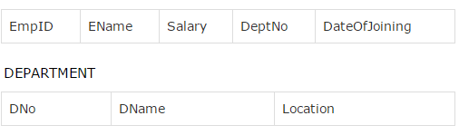
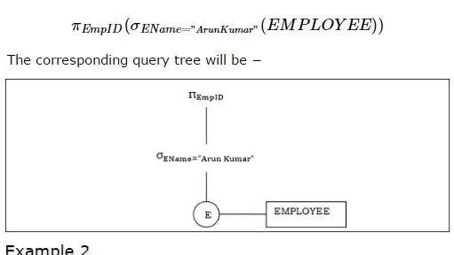
Employee

Slide 17
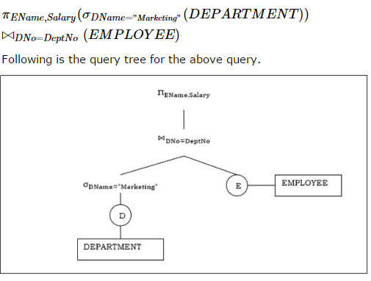

Slide 18
Student(sid,Name,address,phno)
Course(courseid,courseName,fees)
Enrolled(sid,coursed,date)
Faculty(fid,fname,designation)
Teaches(fid,courseid)

Slide 19
Summary(Parsing and Translation Phase):
Parsing:
The query is lexically and syntactaically analyzed .
Verifies relation and attributes specified in query are defined in Data Dictionary(System catalog).
Verifies that any operations applied to the database objects are appropriate for that object type.

Slide 20
Translation:
High level query is translated into intermediate format(RA)
Query tree is formed.
A leaf node is created for each base relation.
A non-leaf(intermediate) node is created for each intermediate relation produced by a relational algebra operation.
The root of the tree represents the result of the query.
The sequence of operations is directed from the leaves to root(DFS)

Slide 21
Basic Steps in Query Processing : Optimization
The cost of the query evaluation can vary for different types of queries.
Although the system is responsible for constructing the evaluation plan, the user does need not to write their query efficiently.
Usually, a database system generates an efficient query evaluation plan, which minimizes its cost.
This type of task performed by the database system and is known as Query Optimization.
For optimizing a query, the query optimizer should have an estimated cost analysis of each operation.
It is because the overall operation cost depends on the memory allocations to several operations, execution costs, and so on.

Slide 22
Basic Steps in Query Processing : Optimization
Optimization:
Optimization is the process of selecting the most efficient query evaluation plan from among multiple stretigies possible for processing a given query.
Optimizer uses the statistical data stored as part of data dictionary.
The statistical data are information about the size of the table, the length of records, the indexes created on the table, etc.
Optimizer also checks for the conditions and conditional attributes which are parts of the query.
Query Optimization: Amongst all equivalent evaluation plans choose the one with lowest cost.

Slide 23
For any given query, there may be a number of different ways to execute it.
Each operation in the query (SELECT, JOIN, etc.) can be implemented using one or more different Access Routines.
For example, an access routine that employs an index to retrieve some rows would be more efficient that an access routine that performs a full table scan.
The goal of the query optimizer is to find a reasonably efficient strategy for executing the query using the access routines.

Slide 24
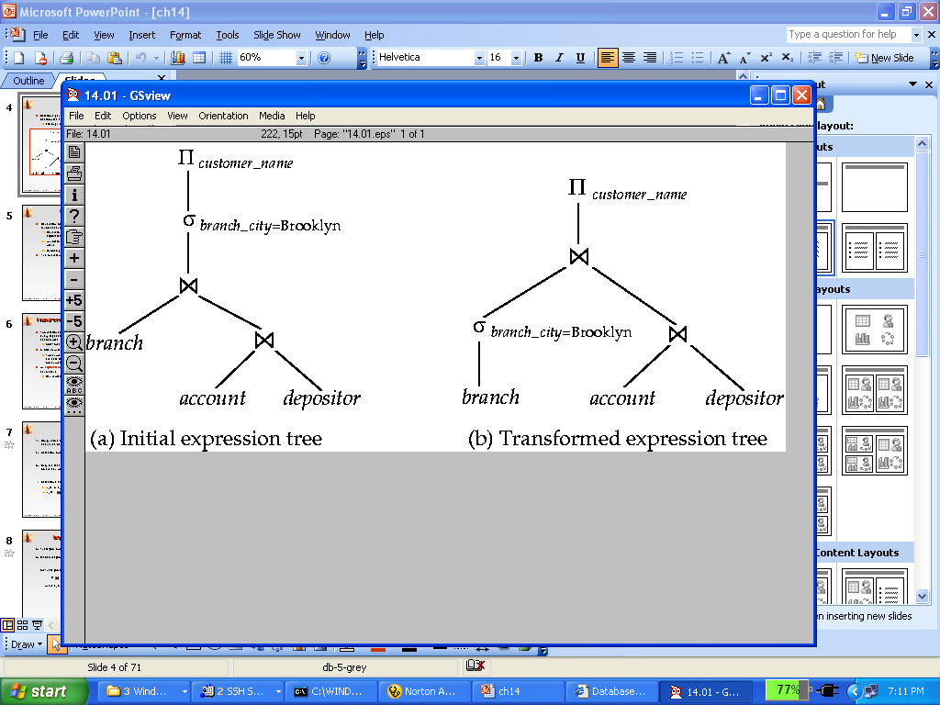
Alternative ways of evaluating a given query
Equivalent expressions
Different algorithms for each operation

Slide 25
Query evaluation plan:
In order to fully evaluate a query, the system needs to construct a query evaluation plan.
The annotations in the evaluation plan may refer to the algorithms to be used for the particular index or the specific operations.
Such relational algebra with annotations is referred to as Evaluation Primitives.
The evaluation primitives carry the instructions needed for the evaluation of the operation.
Thus, a query evaluation plan defines a sequence of primitive operations used for evaluating a query.
The query evaluation plan is also referred to as the query execution plan.
A query execution engine is responsible for generating the output of the given query. It takes the query execution plan, executes it, and finally makes the output for the user query.

Slide 26
Query evaluation plan:
Annotated expression specifying detailed evaluation strategy is called an evaluation-plan.
After the query tree is generated, a query plan is made. A query plan is an extended query tree that includes access paths for all operations in the query tree.
Access paths specify how the relational operations in the tree should be performed.
For example, a selection operation can have an access path that gives details about the use of B+ tree index for selection.
Besides, a query plan also states how the intermediate tables should be passed from one operator to the next, how temporary tables should be used and how operations should be pipelined/combined.

Slide 27
Annotated expression specifying detailed evaluation strategy is called an evaluation-plan.
Sequence of operations that can be used to evaluate a query is called Query Evaluation Plan.
E.g., can use an index on balance to find accounts with balance < 2500,
or can perform complete relation scan and discard accounts with balance ≥ 2500
Query evaluation plan are represented as tree of relational operators, along with labels that can be performed at every node

Slide 28
Query Evaluation Plans
A query evaluation plan (or simply a plan) consists of an extended relational algebra tree (or simply a tree)
A plan tree consists of annotations at each node indicating:
The access methods to use for each relation
The implementation method to use for each operator
Consider the following SQL query Q:
What is the corresponding RA of Q?
SELECT S.sname
FROM Reserves R, Sailors S
WHERE R.sid=S.sid AND
R.bid=100 AND S.rating>5

Slide 29
Query Evaluation Plans (Cont’d)
Q can be expressed in relational algebra as follows:
A RA Tree:
An Extended RA Tree:
(On-the-fly)
sname
sname
bid=100
rating > 5
(On-the-fly)
bid=100
rating > 5
(Simple Nested Loops)
sid=sid
sid=sid
Reserves
Sailors
(File Scan)
Reserves
Sailors
(File Scan)

Slide 30
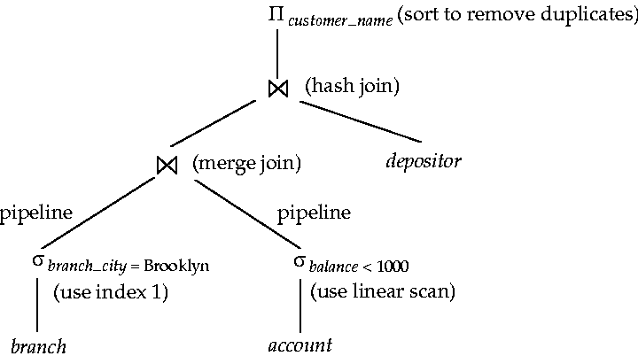
An evaluation plan defines exactly what algorithm is used for each operation, and how the execution of the operations is coordinated.

Slide 31
The plan generator explores various plans for a query block by trying out different access paths, join methods, and join orders.
Many plans are possible because of the various combinations that the database can use to produce the same result.
The optimizer picks the plan with the lowest cost.
The following graphic shows the optimizer testing different plans for an input query.

Slide 32
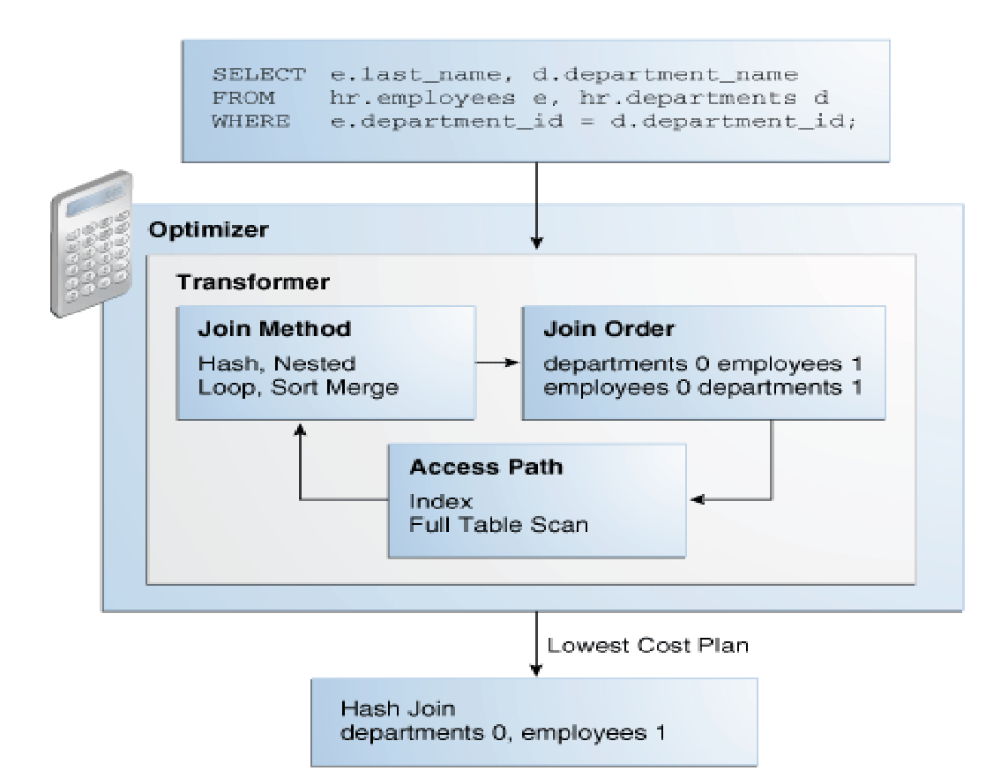

Slide 33
Evaluation:
The query-execution engine takes a query-evaluation plan, executes that plan, and returns the answers to the query.
The runtime database processor then executes the access routines against the database.
The results are returned to the application

Slide 34
Summary:
The main goal of creating a database is to store the related data at one place, access and manipulate them as and when it is required by the user.
Accessing and manipulating the data should be done efficiently i.e. it should be accessed easily and quickly.
This SQL is a high level language created to build a bridge between user and DBMS for their communication.
But the underlying systems in the DBMS will not understand SQL.
There has to be some low level language which these systems can understand.

Slide 35
Any query written in SQL is converted into low level language using relational algebra which system can understand.
But it will be difficult for any user to directly write relational algebra kind of queries. It requires thorough knowledge of it.
Hence what DBMS does is it asks its users to write query in SQL.
It verifies the code written by the user and then converts them into low level languages.
It then selects the best execution path and executes the query and gets the data from internal memory.
All these processes are together known as query processing.

Slide 36
Query Processing
It is the step by step process of breaking the high level language into low level language which machine can understand and perform the requested action for user. Query processor in the DBMS performs this task.

Slide 37
The major steps involved in query processing:

Slide 38
When a query is submitted to the database, it is received by the query compiler.
It then scans the query and divides it into individual tokens.
Once the tokens are generated, they are verified for their correctness by the parser.
Then the tokenized queries are transformed into different possible relational expressions, relational trees and relational graphs (Query Plans).
Query optimizer then picks them to identify the best query plan to process.
It checks in the system catalog for the constraints and indexes and decides the best query plan. It generates different execution plans for the query plan.

Slide 39
The query execution plan then decides the best and optimized execution plan for execution.
The command processor(Query Evaluation Engine) then uses this execution plan to retrieve the data from the database and returns the result.

Slide 40
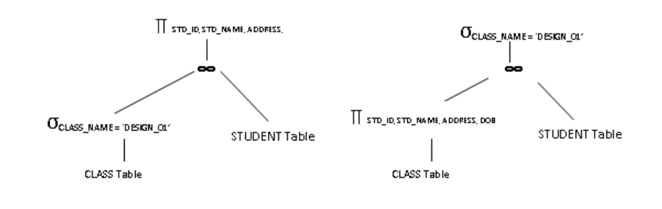
SQL: SELECT STD_ID, STD_NAME, ADDRESS, DOB
FROM STUDENT s, CLASS c
WHERE s.CLASS_ID = c.CLASS_ID
AND c.CLASS_NAME = ‘DESIGN_01’;
RA: 1.∏ STD_ID, STD_NAME, ADDRESS, DOB (σ CLASS_NAME = ‘DESIGN_01’ (STUDENT ∞CLASS))
2. σ CLASS_NAME = ‘DESIGN_01’ (∏ STD_ID, STD_NAME, ADDRESS, DOB (STUDENT ∞CLASS))

Slide 41
Student(sid,Name,address,phno)
Course(courseid,courseName,fees)
Enrolled(sid,coursed,date)
Faculty(fid,fname,designation)
Teaches(fid,courseid)
Consider above database and write equivalent Relational Algebra expression and draw Query Tree for
the following queries:
1.Display name of students who has enrolled for Java and SQL course.
2.Display names of students who has enrolled for course for which instructor(faculty) is John.
3.Display name of the student,course name for which student has enrolled and Name of the faculty who is teaching that course.

Slide 42
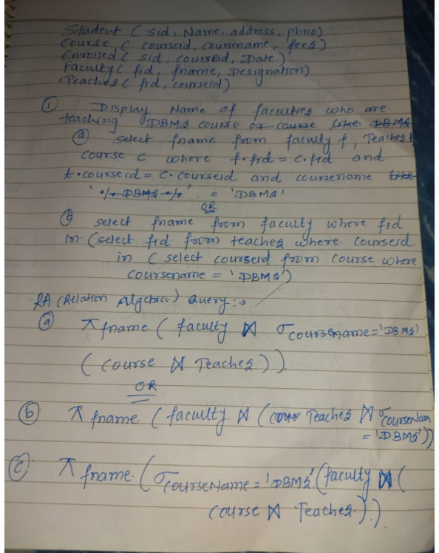

Slide 43
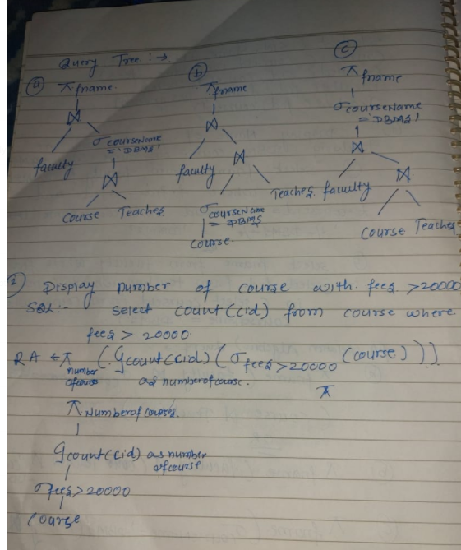

Slide 44
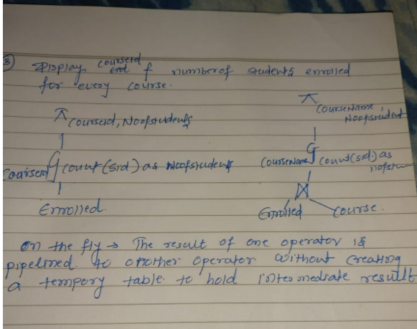

Slide 45
Measures of Query Cost
Cost is generally measured as total elapsed time for answering query
Many factors contribute to time cost
disk accesses, CPU, or even network communication
Typically disk access is the predominant cost, and is also relatively easy to estimate. Measured by taking into account
Number of seeks * average-seek-cost
+ Number of blocks read * average-block-read-cost
+ Number of blocks written * average-block-write-cost
Cost to write a block is greater than cost to read a block
data is read back after being written to ensure that the write was successful

Slide 46
Measures of Query Cost (Cont.)
For simplicity we just use the number of block transfers from disk and the number of seeks as the cost measures
t_{T} – time to transfer one block
t_{S} – time for one seek
Cost for b block transfers plus S seeks b * t_{T} + S * t_{S}
We ignore CPU costs for simplicity
Real systems do take CPU cost into account
We do not include cost to writing output to disk in our cost formulae
Several algorithms can reduce disk IO by using extra buffer space

Slide 47
Query Optimization

Slide 48
Query optimization is the process to find a reasonably efficient strategy for executing the query using the access routines.
Amongst all equivalent evaluation plans choose the one with lowest cost.
Importance of Query Optimization
Query optimization provides faster query processing.
It requires less cost per query.
It gives less stress to the database.
It provides high performance of the system.
It consumes less memory.

Slide 49
Types of Query optimization :
We divide the query optimization into two types: Heuristic (sometimes called Rule based) and Systematic (Cost based).
In Heuristic Optimization, the query execution is refined based on heuristic rules for reordering the individual operations.
With Cost Based Optimization, the overall cost of executing the query is systematically reduced by estimating the costs of executing several different execution plans.

Slide 50
Heuristic Optimization
Is also called as Rule Based optimization.
A query can be represented as a tree data structure. Operations are at the interior nodes and data items (tables, columns) are at the leaves.
The query is evaluated in a depth-first pattern.

Slide 51
Heuristic Optimization
Query Parser will generate a standard initial Query tree for corresponding expression without doing any optimization.
Query Optimizer will apply:
Heuristic Optimization rules
Heuristic optimization rules utilizes equivalence expressions to transfer initial tree into final.

Slide 52
Heuristic Optimization Rules
The main heuristic is to apply first the operations that reduce the size of intermediate result.
Perform as early as possible SELECT operations to reduce the number of tuples and PROJECT to reduce the number of attributes.
This is done by moving SELECT and PROJECT operation as far down the tree possible.
SELECT-JOIN operation which is most restrictive should be executed first by reordering the leaf nodes and adjusting the rest of the tree appropriately.

Slide 53
Heuristic Optimization:
One of the main heuristic rules is to apply SELECT and PROJECT operations before applying the JOIN or other binary operations.
This is because the size of the file resulting from a binary operation—such as JOIN—is usually a multiplicative function of the sizes of the input files.
The SELECT and PROJECT operations reduce the size of a file and hence should be applied before a join or other binary operation.

Slide 54
Steps in Heuristic Optimization:
Step 1: Design the initial canonical tree of the query
(Canonical tree
• tree where any subtree can be evaluated in any order (informal definition)
Step 2.Deconstruct the conjunctive selections into a sequence of single selection operations.
Step 3: Move the SELECT operation down the query tree Step 4: Apply more restrictive SELECT operation first.
Step 5: Replace CARTESIAN PRODUCT and SELECT with JOIN operation Step
Step 6: Move PROJECT operations down the query tree
Step 7.Apply equivalence rules for further optimization.

Slide 55
Heuristic optimization rules are applied to convert an initial query tree into an equivalent query tree, which represents a relational algebra expression that is more efficient to execute but gives the same result as the original tree.
Heuristic optimization transforms the expression-tree by using a set of rules which improve the performance.

Slide 56
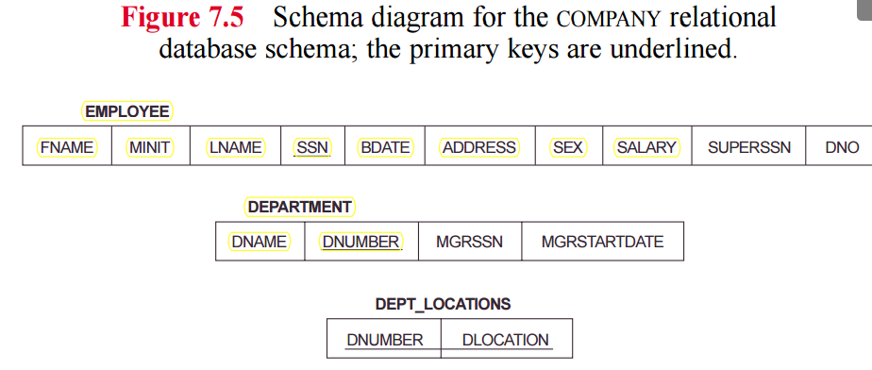
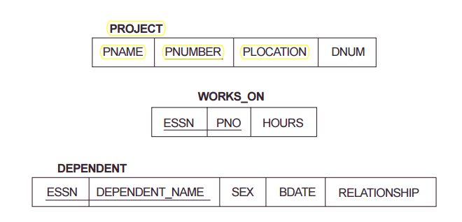

Slide 57
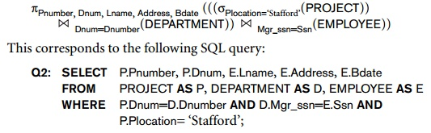
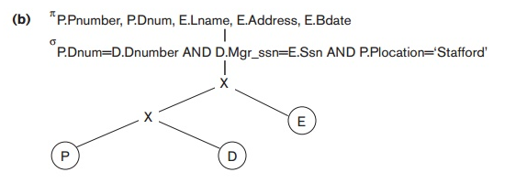
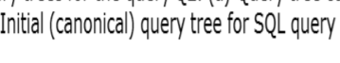

Slide 58
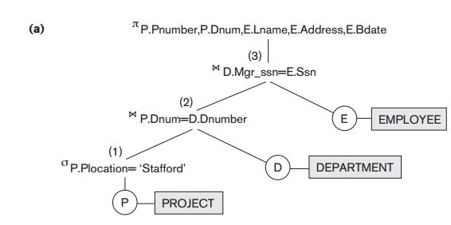


Slide 59
Example of Transforming a Query.
Consider the following query Q: Find the last names of employees born after 1957 who work on a project named ‘Aquarius’. This query can be specified in SQL as follows:
SELECT Lname FROM EMPLOYEE, WORKS_ON, PROJECT
WHERE Pname=‘Aquarius’ AND Pnumber=Pno AND Essn=Ssn AND Bdate > ‘1957-12-31’;

Slide 60
Steps in converting a query tree during heuristic optimization.
Initial (canonical) query tree for SQL query Q.
(canonical tree ia a tree where any subtree can be evaluated in any order)
Moving SELECT operations down the query tree.
Applying the more restrictive SELECT operation first.
Replacing CARTESIAN PRODUCT and SELECT with JOIN operations.
Moving PROJECT operations down the query tree.
Apply Transformation Rules.

Slide 61
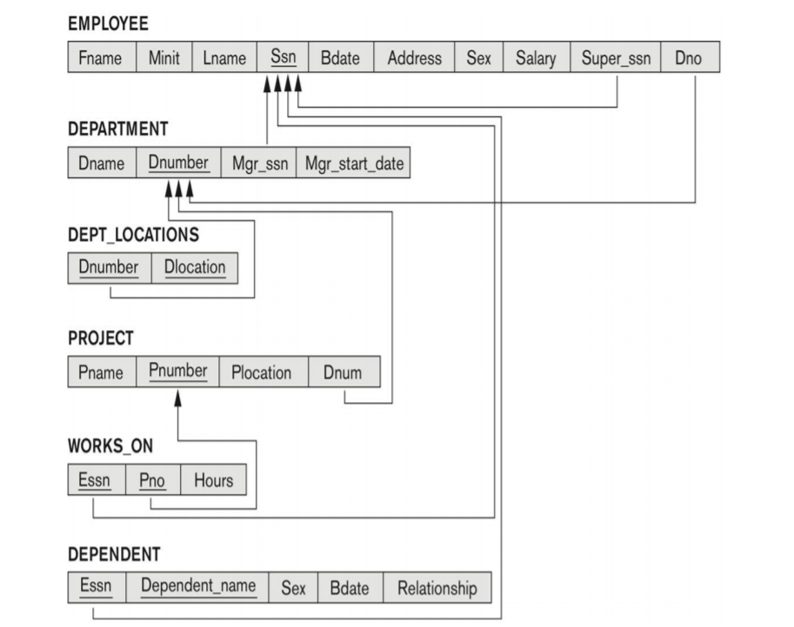

Slide 62
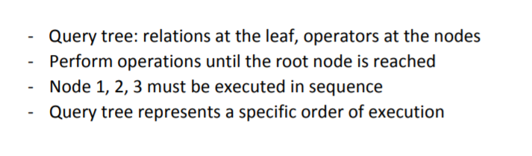

Slide 63

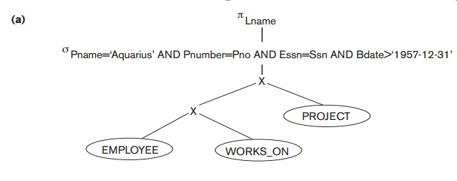

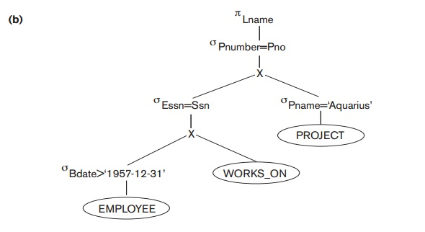


Slide 64
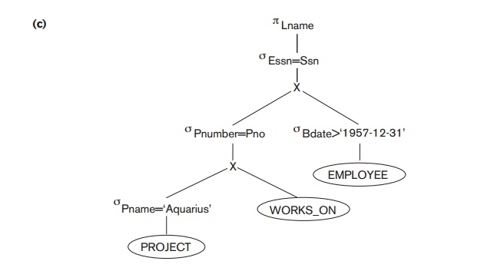


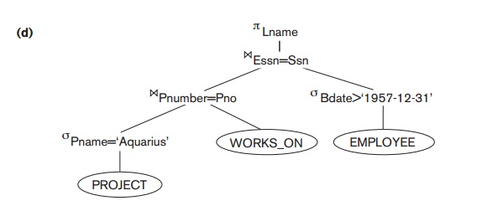



Slide 65
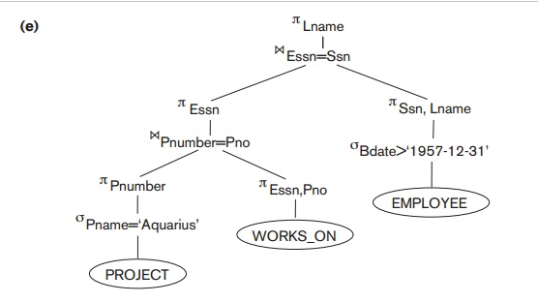


Slide 66
Generating Equivalent Expressions

Slide 67
Transformation of Relational Expressions
Two relational algebra expressions are said to be equivalent if the two expressions generate the same set of tuples on every legal database instance
In SQL, inputs and outputs are multisets of tuples
Two expressions in the multiset version of the relational algebra are said to be equivalent if the two expressions generate the same multiset of tuples on every legal database instance.
An equivalence rule says that expressions of two forms are equivalent
Can replace expression of first form by second, or vice versa

Slide 68
General Transformation Rules for Relational Algebra Operations:
1. Cascade of σ: A conjunctive selection condition can be broken up into a cascade (sequence) of individual σ operations:
σ _{c1 AND c2 AND ... AND cn}(R) = σ_{c1} (σ_{c2} (...(σ_{cn}(R))...) )
Conjunctive selection operations can be written as a sequence of individual selections. This is called a sigma-cascade.
2. Commutativity of σ: The σ operation is commutative:
σ_{c1} (σ_{c2}(R)) = σ_{c2} (σ_{c1}(R))

Slide 69
Using Heuristics in Query Optimization
3. Cascade of π: In a cascade (sequence) of π operations, all but the last one can be ignored:
π_{List1} (π_{List2} (...(π_{Listn}(R))...) ) = π_{List1}(R)
4. Commuting σ with π: If the selection condition c involves only the attributes A1, ..., An in the projection list, the two operations can be commuted:
π_{A1, A2, ..., An} (σ_{c} (R)) = σ_{c} (π_{A1, A2, ..., An} (R))

Slide 70
Using Heuristics in Query Optimization
General Transformation Rules for Relational Algebra Operations (contd.):
5. Commutativity of ( and x ): The operation is commutative as is the x operation:
R _{C} S = S _{C} R; R x S = S x R
6. Commuting σ with (or x ): If all the attributes in the selection condition c involve only the attributes of one of the relations being joined—say, R—the two operations can be commuted as follows:
α) σ_{c} ( R S ) = (σ_{c} (R)) S
Alternatively, if the selection condition c can be written as (c1 and c2), where condition c1 involves only the attributes of R and condition c2 involves only the attributes of S, the operations commute as follows:
β) σ_{c} ( R S ) = (σ_{c1} (R)) (σ_{c2} (S))

Slide 71
Using Heuristics in Query Optimization
General Transformation Rules for Relational Algebra Operations (contd.):
7. Commuting π with (or x):
a)Suppose that the projection list is L = {A1, ..., An, B1, ..., Bm}, where A1, ..., An are attributes of R and B1, ..., Bm are attributes of S. If the join condition c involves only attributes in L, the two operations can be commuted as follows:
π_{L} ( R _{C} S ) = (π_{A1, ..., An} (R)) _{C} (π _{B1, ..., Bm} (S))
b) If the join condition C contains additional attributes not in L, these must be added to the projection list, and a final π operation is needed.

Slide 72
Using Heuristics in Query Optimization
8. Commutativity of set operations: The set operations υ and ∩ are commutative but “–” is not.
9. Associativity of , x, υ, and ∩ : These four operations are individually associative; that is, if θ stands for any one of these four operations (throughout the expression), we have
( R θ S ) θ T = R θ ( S θ T )
10. Commuting σ with set operations: The σ operation commutes with υ , ∩ , and –. If θ stands for any one of these three operations, we have
σ_{c} ( R θ S ) = (σ_{c} (R)) θ (σ_{c} (S))

Slide 73
Using Heuristics in Query Optimization
General Transformation Rules for Relational Algebra Operations (contd.):
11. The π operation commutes with υ. π_{L} ( R υ S ) = (π_{L} (R)) υ (π_{L} (S))
12.
Converting a (σ, x) sequence into : If the condition c of a σ that follows a x Corresponds to a join condition, convert the (σ, x) sequence into a as follows: (σ_{C} (R x S)) = (R _{C} S)
Other transformations

Slide 74
Using Heuristics in Query Optimization
Outline of a Heuristic Algebraic Optimization Algorithm:
Using rule 1, break up any select operations with conjunctive conditions into a cascade of select operations.
Using rules 2, 4, 6, and 10 concerning the commutatively of select with other operations, move each select operation as far down the query tree as is permitted by the attributes involved in the select condition.
Using rule 9 concerning associativity of binary operations, rearrange the leaf nodes of the tree so that the leaf node relations with the most restrictive select operations are executed first in the query tree representation.
Using Rule 12, combine a Cartesian product operation with a subsequent select operation in the tree into a join operation.
Using rules 3, 4, 7, and 11 concerning the cascading of project and the commuting of project with other operations, break down and move lists of projection attributes down the tree as far as possible by creating new project operations as needed.
Identify subtrees that represent groups of operations that can be executed by a single algorithm.

Slide 75
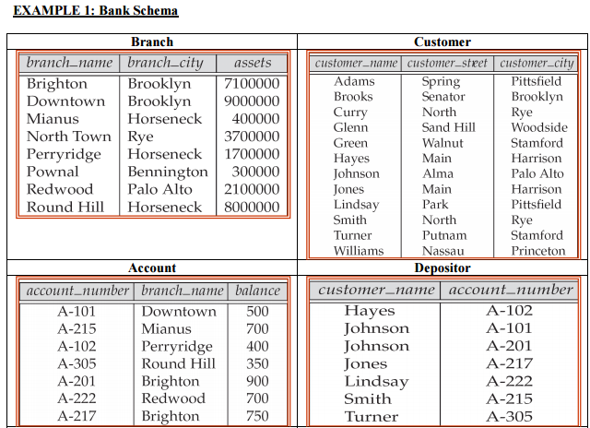
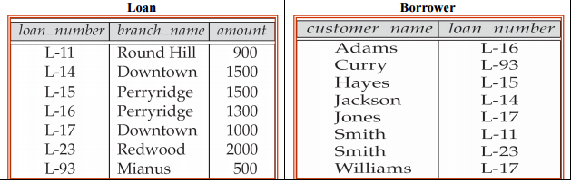

Slide 76
Transformation Example: Pushing Selections
Query: Find the names of all customers who have an account at some branch located in Brooklyn. Π_{customer_name}(σ_{branch_city = “Brooklyn”} (branch (account depositor)))
Transformation using rule 6a. Π_{customer_name} ((σ_{branch_city =“Brooklyn”} (branch)) (account depositor))
Performing the selection as early as possible reduces the size of the relation to be joined.

Slide 77
Example with Multiple Transformations
Query: Find the names of all customers with an account at a Brooklyn branch whose account balance is over $1000. Π_{customer_name(}(σbranch_city = “Brooklyn” ∧ balance > 1000 (branch (account depositor)))
Transformation using join associatively (Rule 6a): Π_{customer_name}((σbranch_city = “Brooklyn” ∧ balance > 1000 (branch account)) depositor)
Second form provides an opportunity to apply the “perform selections early” rule, resulting in the subexpression
σ_{branch_city = “Brooklyn”} (branch) σ _{balance > 1000} (account)
Thus a sequence of transformations can be useful
c

Slide 78
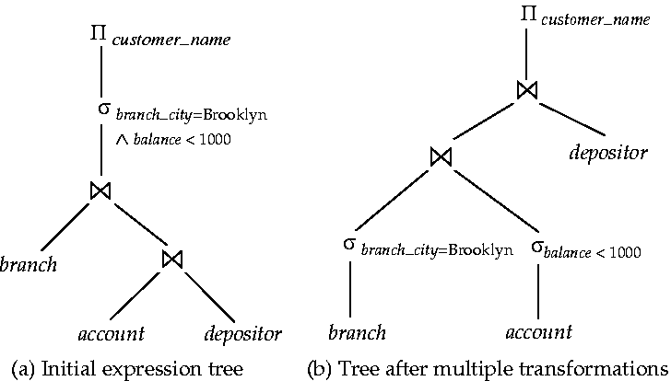
Multiple Transformations (Cont.)

Slide 79
Transformation Example: Pushing Projections
Π_{customer_name}((σ_{branch_city = “Brooklyn”} (branch) account) depositor)
When we compute
(σ_{branch_city = “Brooklyn”} (branch) account ) we obtain a relation whose schema is: (branch_name, branch_city, assets, account_number, balance)
Push projections using equivalence rules 8a and 8b; eliminate unneeded attributes from intermediate results to get: Π_{customer_name} (( Π_{account_number} ( (σ_{branch_city = “Brooklyn”} (branch) account )) depositor )
Performing the projection as early as possible reduces the size of the relation to be joined.

Slide 80
Join Ordering Example (Cont.)
Consider the expression
Π_{customer_name} ((σ_{branch_city = “Brooklyn”} (branch)) (account depositor))
Could compute account depositor first, and join result with σ_{branch_city = “Brooklyn”} (branch) but account depositor is likely to be a large relation.
Only a small fraction of the bank’s customers are likely to have accounts in branches located in Brooklyn
it is better to compute
σ_{branch_city = “Brooklyn”} (branch) account
first.

Slide 81
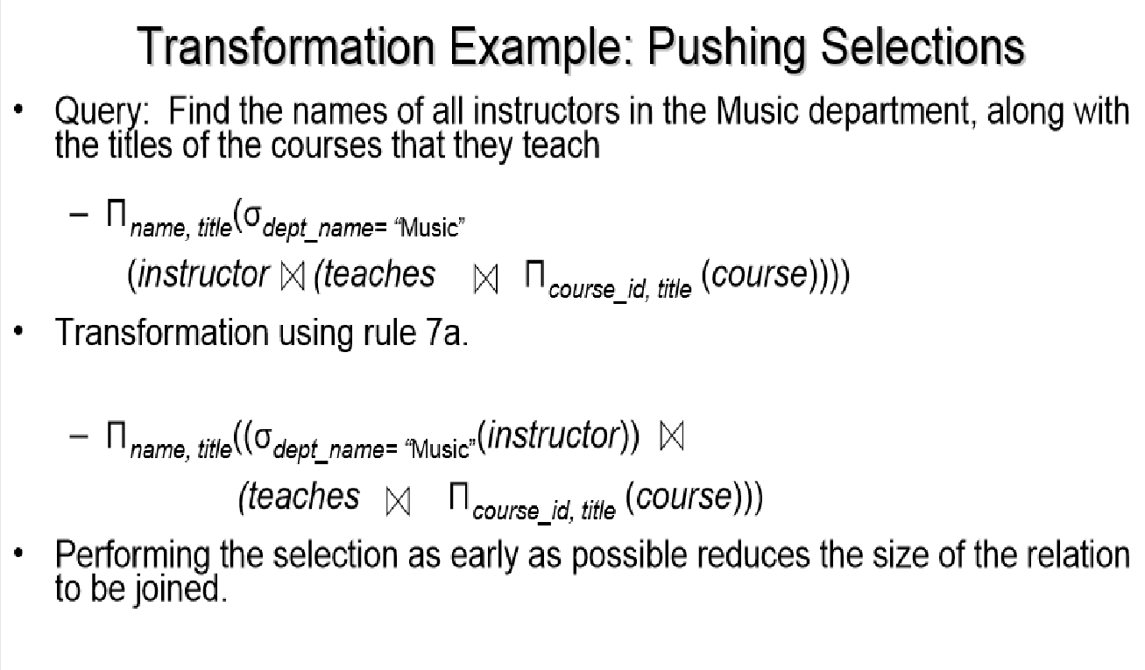

Slide 82
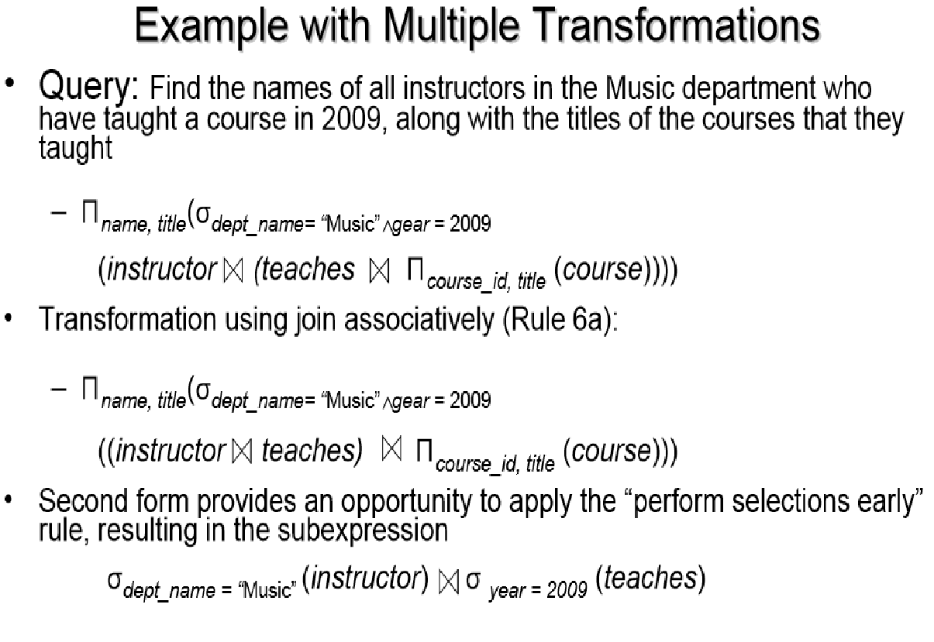

Slide 83
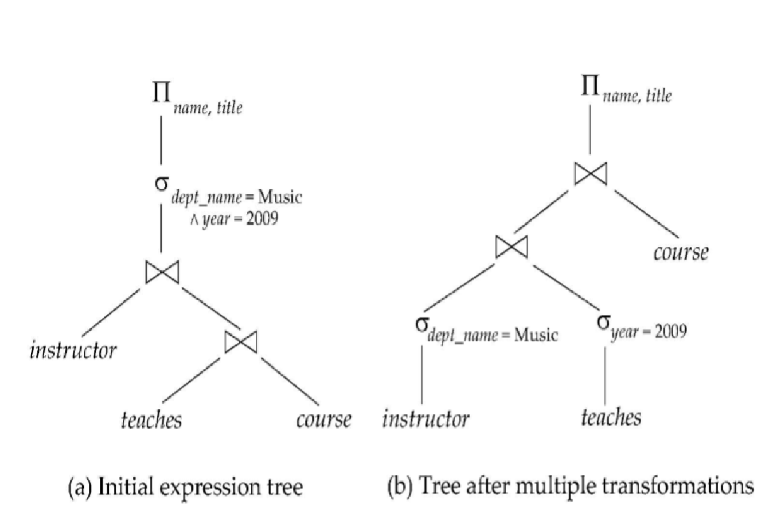

Slide 84
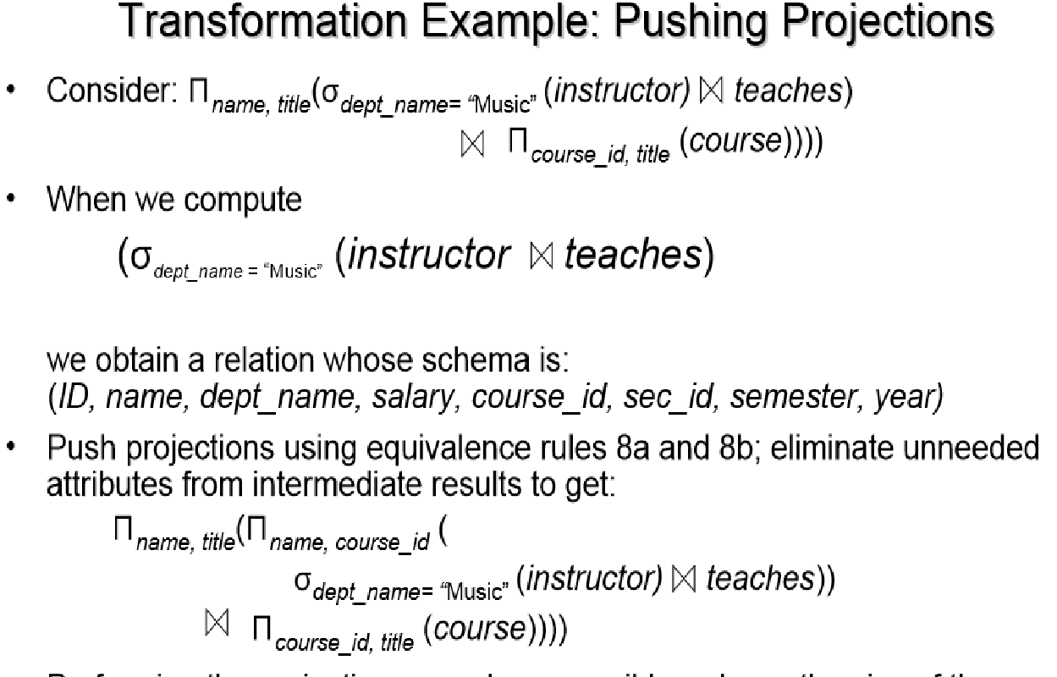

Slide 85
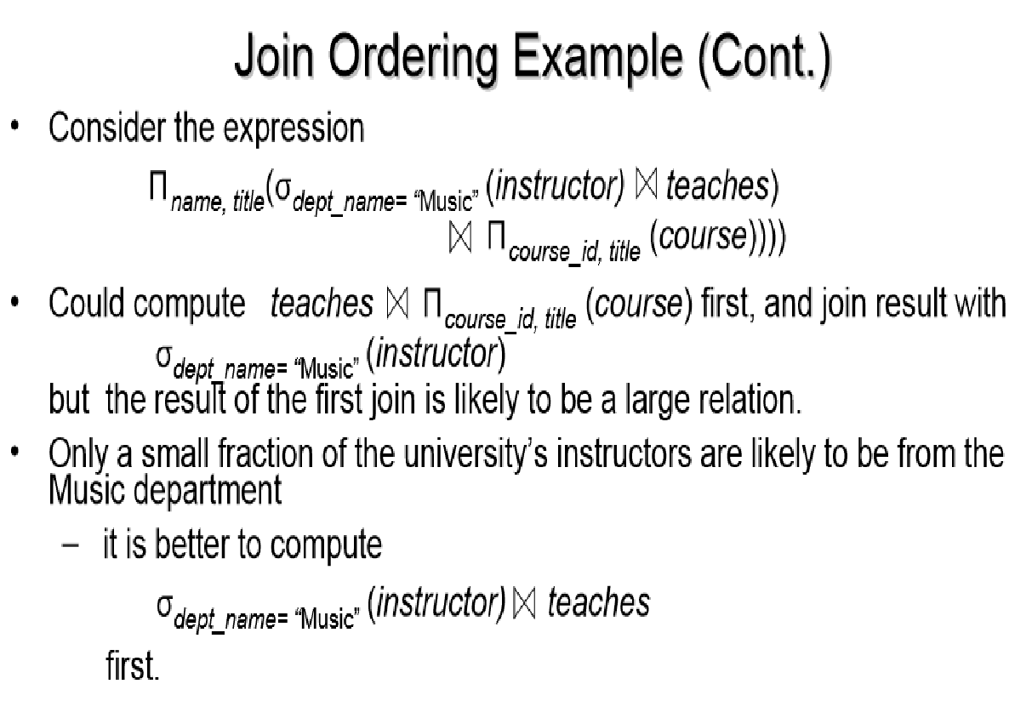

Slide 86
Using Heuristics in Query Optimization
Summary of Heuristics for Algebraic Optimization:
The main heuristic is to apply first the operations that reduce the size of intermediate results.
Perform select operations as early as possible to reduce the number of tuples and perform project operations as early as possible to reduce the number of attributes. (This is done by moving select and project operations as far down the tree as possible.)
The select and join operations that are most restrictive should be executed before other similar operations. (This is done by reordering the leaf nodes of the tree among themselves and adjusting the rest of the tree appropriately.)

Slide 87
Using Heuristics in Query Optimization
Query Execution Plans
An execution plan for a relational algebra query consists of a combination of the relational algebra query tree and information about the access methods to be used for each relation as well as the methods to be used in computing the relational operators stored in the tree.
Materialized evaluation: the result of an operation is stored as a temporary relation.
Pipelined evaluation: as the result of an operator is produced, it is forwarded to the next operator in sequence.

Slide 88
An evaluation plan defines exactly what algorithm is used for each operation, and how the execution of the operations is coordinated.

Slide 89
Query Processing Steps:
Optimized
Relational
algebra
expression
Relational
algebra
expression
Query
execution
plan
Executable
code
SQL
Code
generator
parser
Query optimizer
DBMS

Slide 90
Alternative ways of evaluating a given query
Equivalent expressions
Different algorithms for each operation
Cost difference between a good and a bad way of evaluating a query can be enormous
Need to estimate the cost of operations
Statistical information about relations. Examples:
number of tuples,
number of distinct values for an attributes, etc.
Statistics estimation for intermediate results
to compute cost of complex expressions

Slide 91
Relations generated by two equivalent expressions have the same set of attributes and contain the same set of tuples
although their tuples/attributes may be ordered differently.

Slide 92
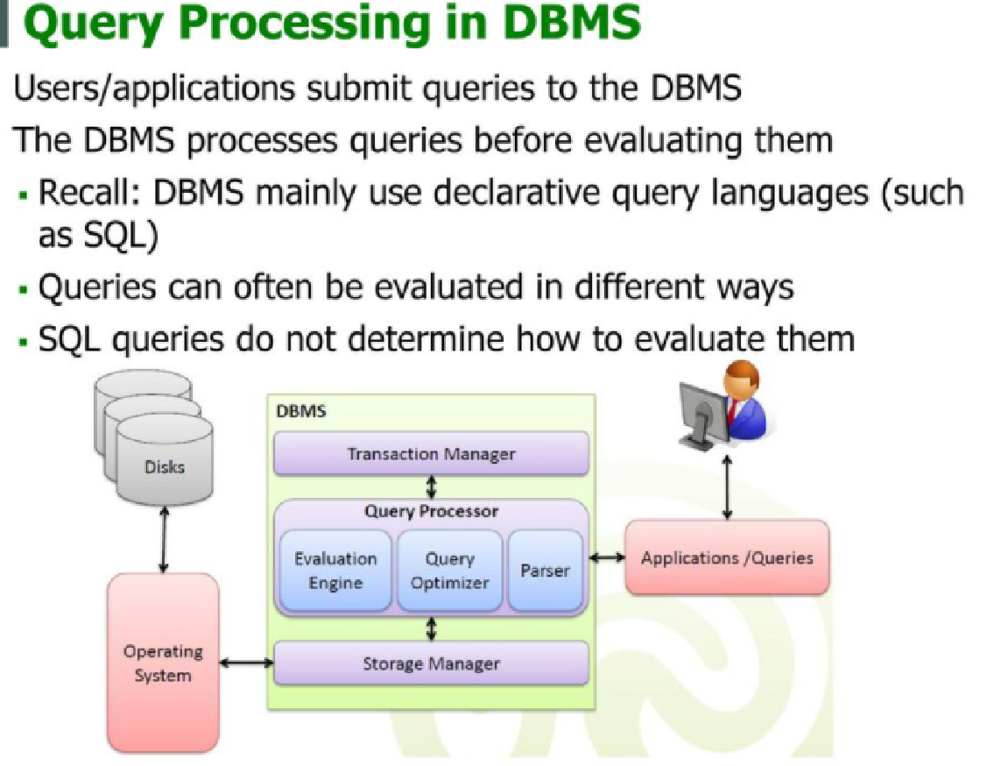

Slide 93
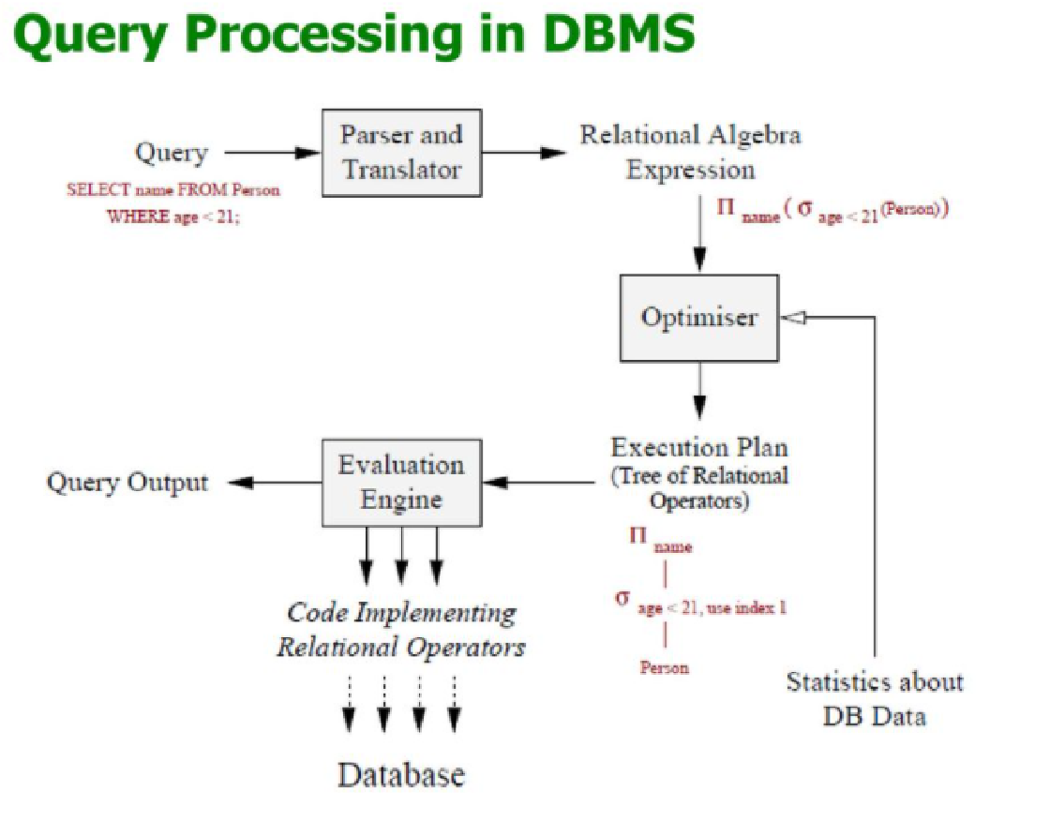

Slide 94
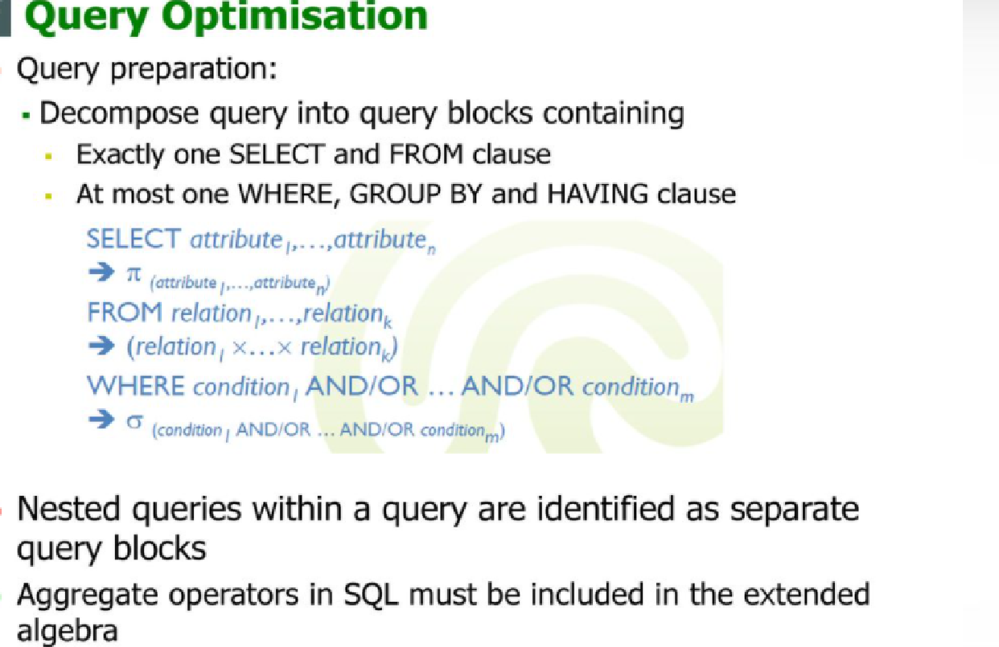

Slide 95
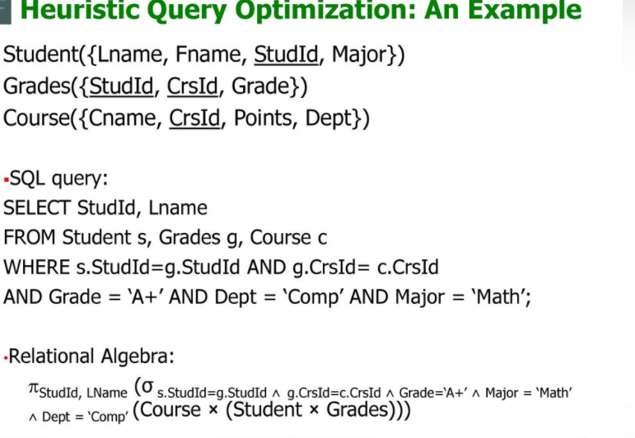

Slide 96
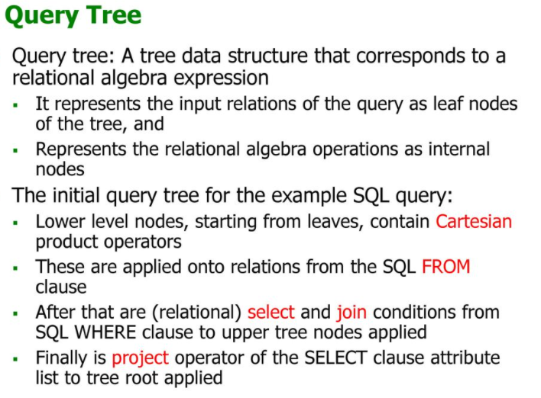

Slide 97
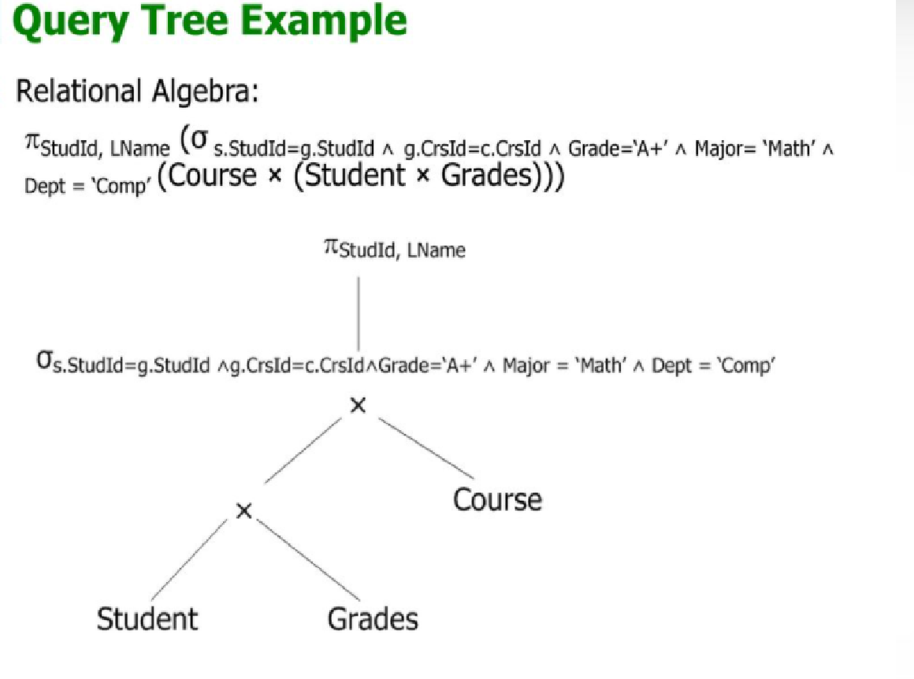

Slide 98
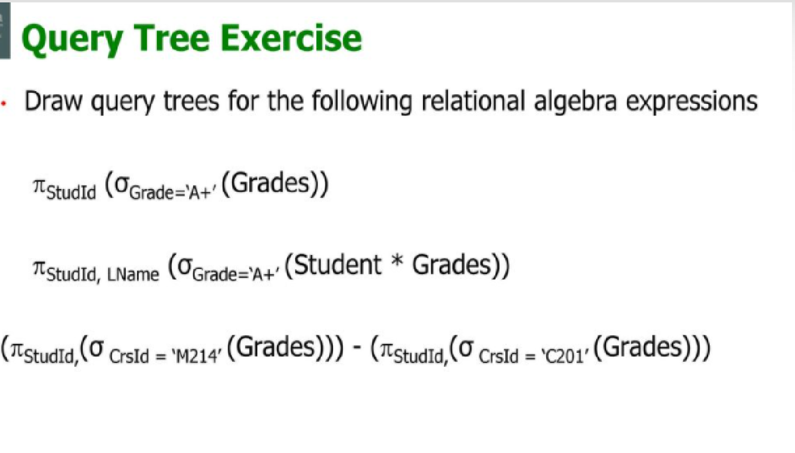

Slide 99
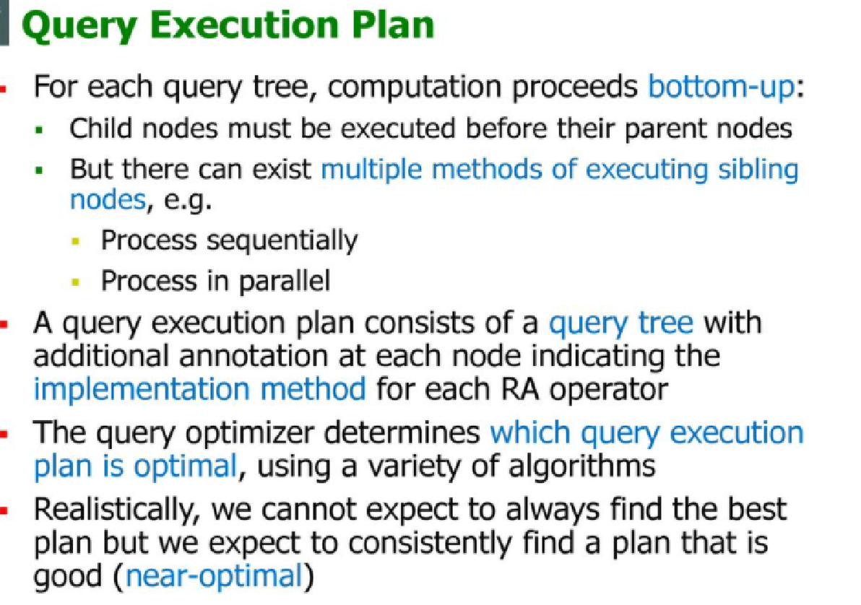

Slide 100
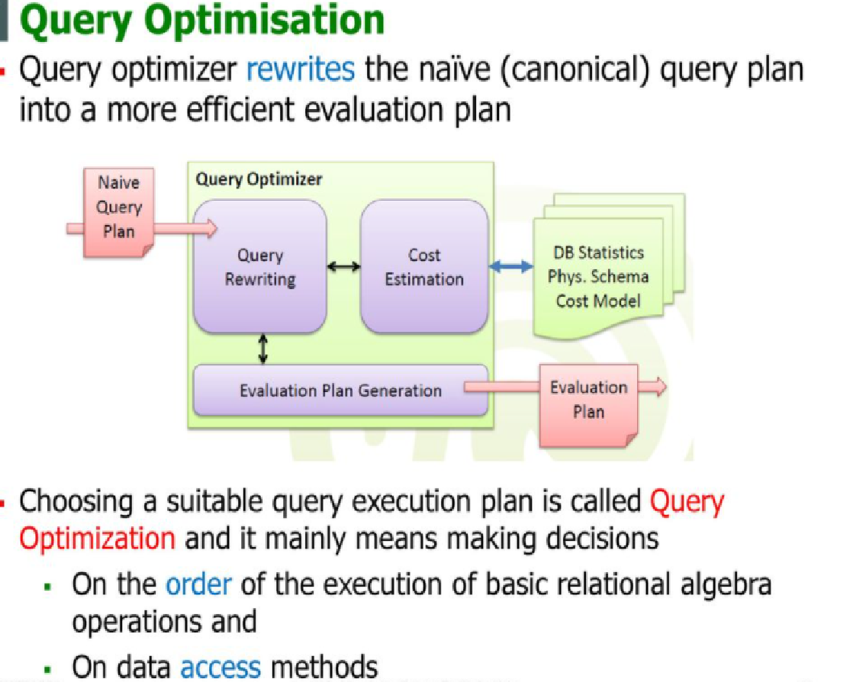

Slide 101
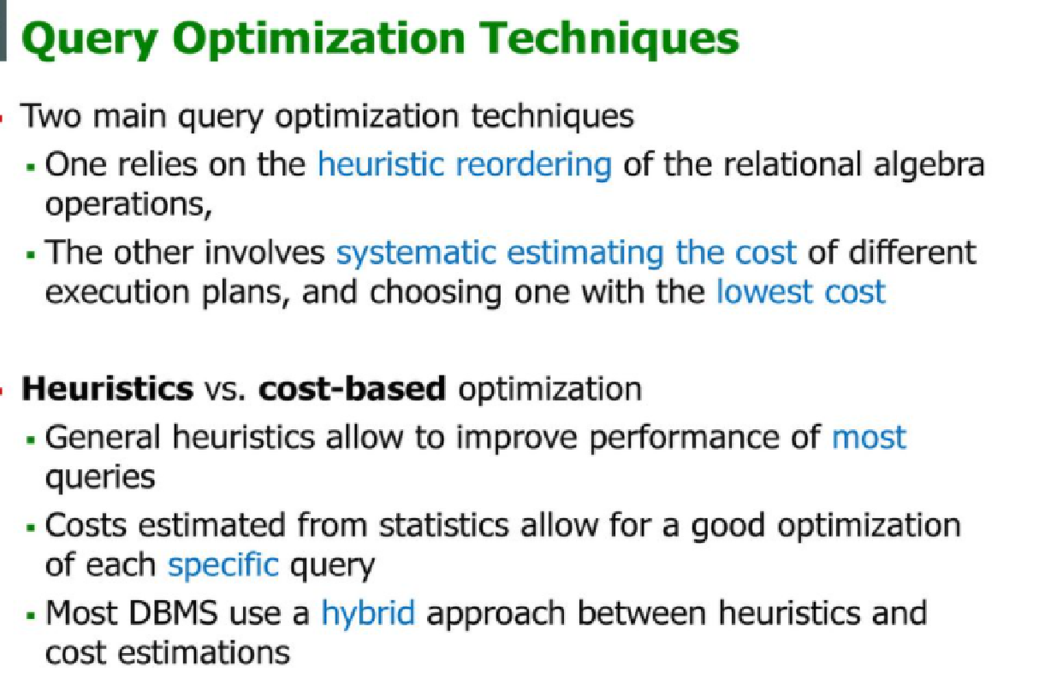

Slide 102
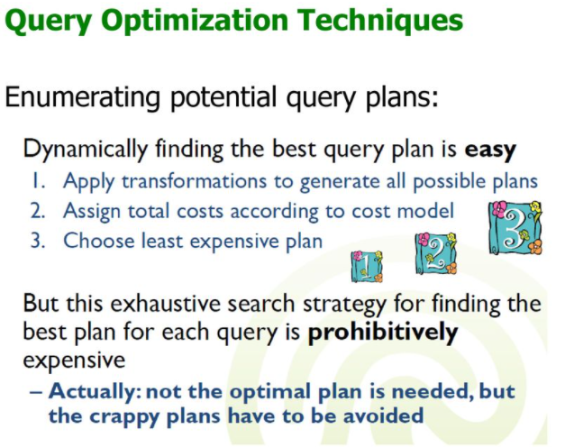

Slide 103
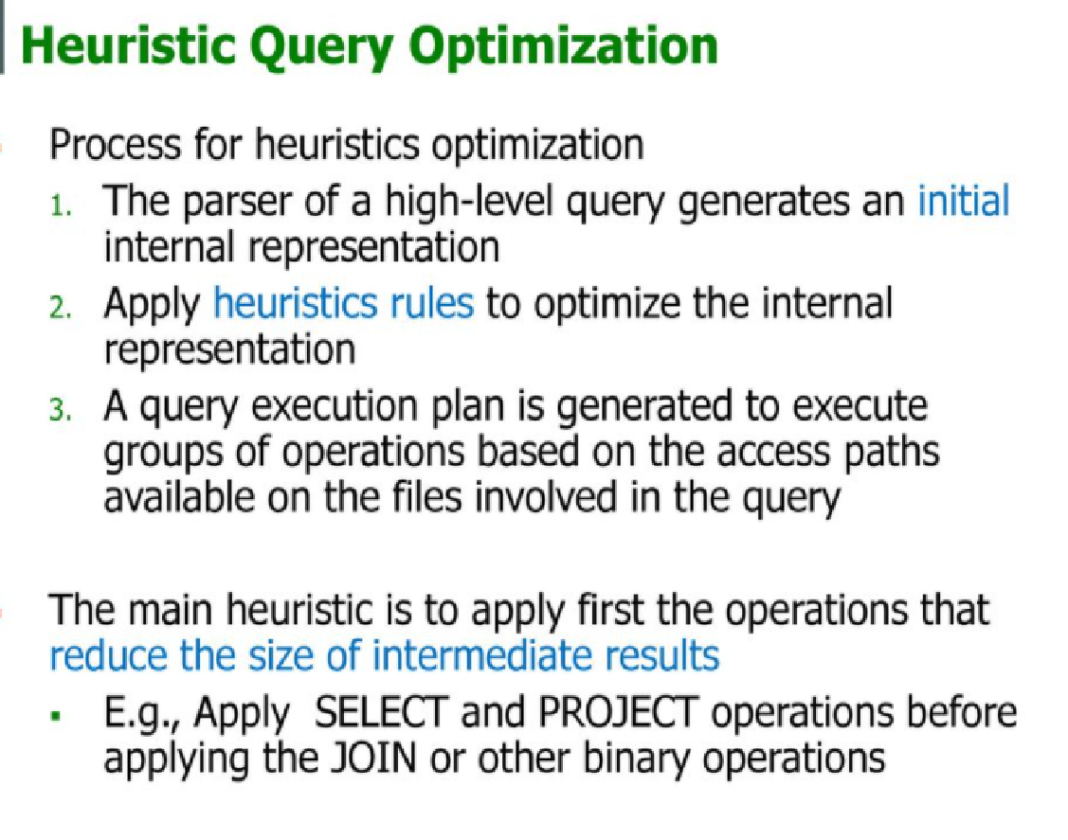

Slide 104
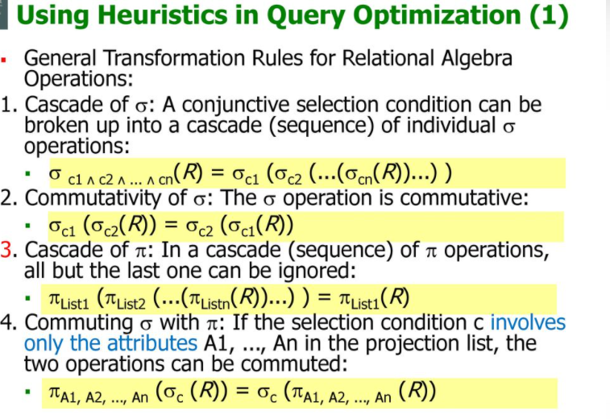

Slide 105
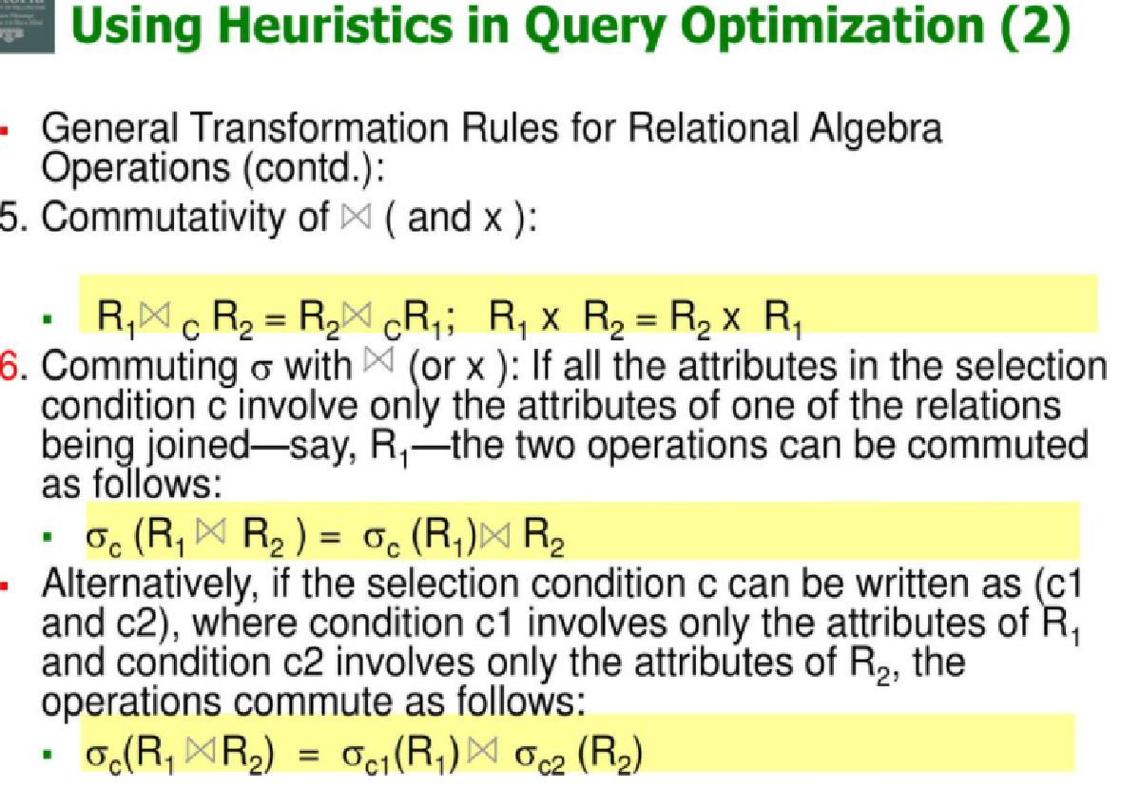

Slide 106
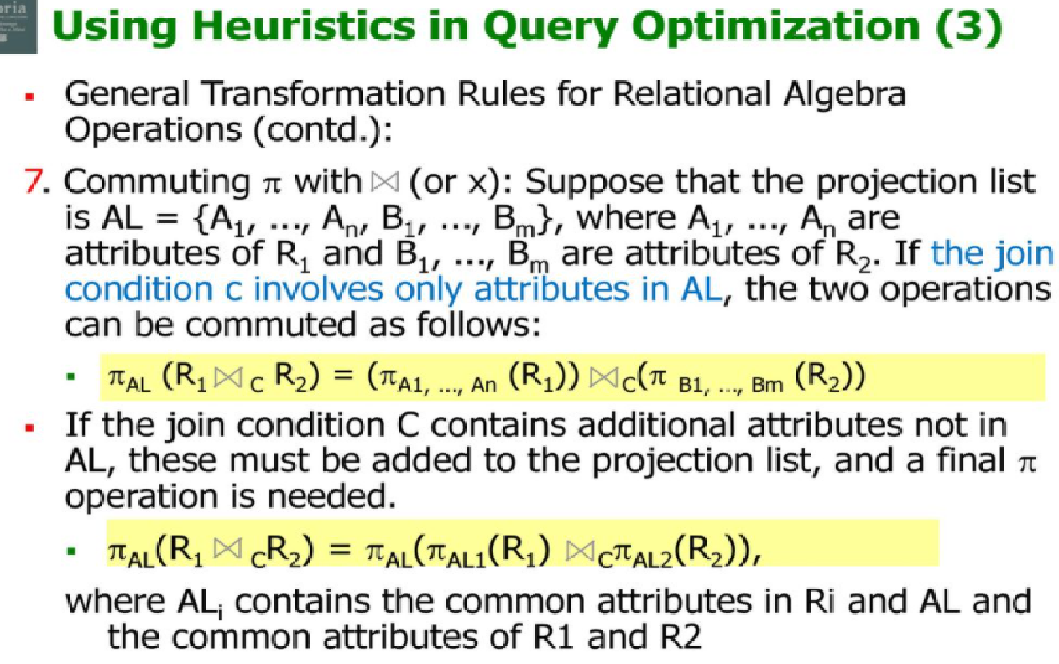

Slide 107
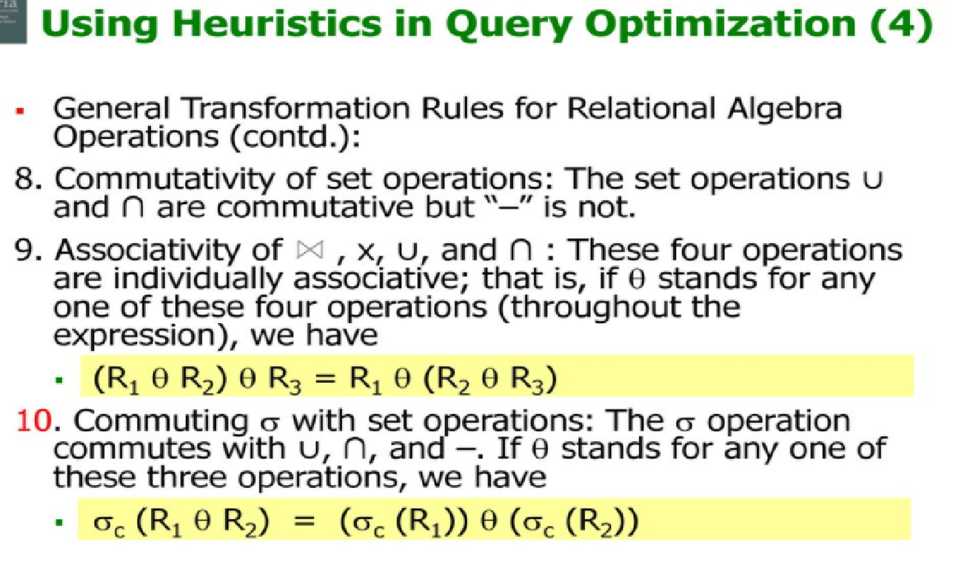

Slide 108
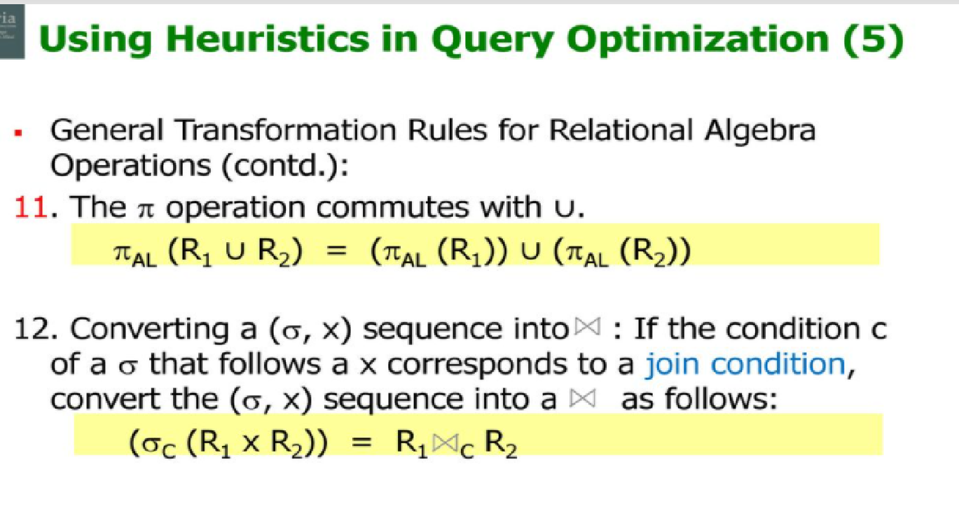

Slide 109


Slide 110


Slide 111


Slide 112


Slide 113


Slide 114


Slide 115


Slide 116


Slide 117
Example:
SELECT PNUMBER, DNUM, LNAME
FROM PROJECT, DEPARTMENT, EMPLOYEE
WHERE DNUM=DNUMBER and MGREMPID=EMPID and PLOCATION = 'Stafford';
Relational Algebra:

Slide 118

Relational Algebra Tree:

Slide 119
Heuristic Query Optimization
A query can be represented as a tree data structure. Operations are at the interior nodes and data items (tables, columns) are at the leaves.
The query is evaluated in a depth-first pattern.

Slide 120


Slide 121


Slide 122
An overall rule for heuristic query optimization is to perform as many select and project operations as possible before doing any joins.
There are a number of transformation rules that can be used to transform a query:
Cascading selections. A list of conjunctive conditions can be broken up into separate individual conditions.
Commutativity of the selection operation.
Cascading projections. All but the last projection can be ignored.
Commuting selection and projection. If a selection condition only involves attributes contained in a projection clause, the two can be commuted.

Slide 123
Commutativity of Join and Cross Product.
Commuting selection with Join.
Commuting projection with Join.
Commutativity of set operations. Union and Intersection are commutative.
Associativity of Union, Intersection, Join and Cross Product.
Commuting selection with set operations.
Commuting projection with set operations.
Combine Selection and Cartesian product to form Joins.

Slide 124
These transformations can be used in various combinations to optimize queries. Some general steps follow:
Using rule 1, break up conjunctive selection conditions and chain them together.
Using the commutativity rules, move the selection operations as far down the tree as possible.
Using the associativity rules, rearrange the leaf nodes so that the most restrictive selection conditions are executed first. For example, an equality condition is likely more restrictive than an inequality condition (range query).
Combine cartesian product operations with associated selection conditions to form a single Join operation.
Using the commutativity of Projection rules, move the projection operations down the tree to reduce the sizes of intermediate result sets.
Finally, identify subtrees that can be executed using a single efficient access method.

Slide 125

Example of Heuristic Query Optimization
1. Original Query Tree

Slide 126

2. Use Rule 1 to Break up Cascading Selections

Slide 127

3. Commute Selection with Cross Product

Slide 128

4. Combine Cross Product and Selection to form Joins

Slide 129


Slide 130


Slide 131
Example:
Student(sid,Name,address,phno)
Course(courseid,courseName,fees)
Enrolled(sid,courseid,date)
Faculty(fid,fname,designation)
Teaches(fid,courseid)

Slide 132


Slide 133


Slide 134


Slide 135


Slide 136
Cost Based Optimization:
A query optimizer does not depend solely on heuristic rules.
It also estimates and compares the costs of executing a query using different execution strategies and algorithms, and it then chooses the strategy with the lowest cost estimate.
For this approach to work, accurate cost estimates are required so that different strategies can be compared fairly and realistically.
In addition, the optimizer must limit the number of execution strategies to be considered .

Slide 137
This approach is generally referred to as cost-based query optimization.
It uses traditional optimization techniques that search the solution space to a problem for a solution that minimizes an objective (cost) function.
The cost functions used in query optimization are estimates and not exact cost functions, so the optimization may select a query execution strategy that is not the optimal (absolute best) one.

Slide 138
Cost Estimation in Query Optimization
The main aim of query optimization is to choose the most efficient way of implementing the relational algebra operations at the lowest possible cost.
The query optimizer should not depend solely on heuristic rules, but, it should also estimate the cost of executing the different strategies and find out the strategy with the minimum cost estimate.

Slide 139
The cost functions used in query optimization are estimates and not exact cost functions.
The cost of an operation is heavily dependent on its selectivity, that is, the proportion of select operation(s) that forms the output.
In general the different algorithms are suitable for low or high selectivity queries.
In order for query optimizer to choose suitable algorithm for an operation an estimate of the cost of executing that algorithm must be provided

Slide 140
The cost of an algorithm is depend of a cardinality of its input.
To estimate the cost of different query execution strategies, the query tree is viewed as containing a series of basic operations which are linked in order to perform the query.
It is also important to know the expected cardinality of an operation’s output because this forms the input to the next operation.

Slide 141
Cost Components of Query Execution
The cost of executing the query includes the following components:
Access cost to secondary storage.
Storage cost.
Computation cost.
Memory uses cost.
Communication cost.

Slide 142
Cost Components for Query Execution:
The cost of executing a query includes the following components:
Access cost to secondary storage.
This is the cost of transferring (reading and writing) data blocks between secondary disk storage and main memory buffers. This is also known as disk I/O (input/output) cost.
The cost of searching for records in a disk file depends on the type of access structures on that file, such as ordering, hashing, and primary or secondary indexes.
In addition, factors such as whether the file blocks are allocated contiguously on the same disk cylinder or scattered on the disk affect the access cost.
Disk storage cost.
This is the cost of storing on disk any intermediate files that are generated
by an execution strategy for the query.

Slide 143
Computation cost. This is the cost of performing in-memory operations on the records within the data buffers during query execution. Such operations include searching for and sorting records, merging records for a join or a sort operation, and performing computations on field values. This is also known as CPU (central processing unit) cost.
Memory usage cost. This is the cost pertaining to the number of main memory buffers needed during query execution.
Communication cost. This is the cost of shipping the query and its results from the database site to the site or terminal where the query originated.

Slide 144
Importance of Access cost
Out of the above five cost components, the most important is the secondary storage access cost.
The emphasis of the cost minimization depends on the size and type of database applications.
For example in smaller database the emphasis is on the minimizing computing cost as because most of the data in the files involve in the query can be completely store in the main memory.
For large database, the main emphasis is on minimizing the access cost to secondary device.

Slide 145
For distributed database, the communication cost is minimized as because many sites are involved for the data transfer.
To estimate the cost of various execution strategies, we must keep track of any information that is needed for the cost function.
This information may be stored in database catalog, where it is accessed by the query optimizer.

Slide 146


Slide 147


Slide 148


Slide 149


Slide 150


Slide 151


Slide 152


Slide 153


Slide 154


Slide 155


Slide 156


Slide 157


Slide 158


Slide 159


Slide 160


Slide 161


Slide 162


Slide 163


Slide 164


Slide 165


Slide 166



Slide 167


Slide 168


Slide 169



Slide 170


Slide 171



Slide 172
Measures of Query Cost (Cont.)
For simplicity we just use the number of block transfers from disk and the number of seeks as the cost measures
t_{T} – time to transfer one block
t_{S} – time for one seek
b- number of block transfer
s- number of of seek
Cost for b block transfers plus S seeks b * t_{T} + S * t_{S}
We ignore CPU costs for simplicity
Real systems do take CPU cost into account
We do not include cost to writing output to disk in our cost formulae

Slide 173


Slide 174
Join Operation
Several different algorithms to implement joins
Nested-loop join
Block nested-loop join
Indexed nested-loop join
Merge-join
Hash-join
Choice based on cost estimate
Examples use the following information
Number of records of student: 5,000 takes: 10,000
Number of blocks of student: 100 takes: 400

Slide 175
Nested-Loop Join(Brute Force Join)
To compute the theta join r _{θ} s for each tuple t_{r} in r do begin for each tuple t_{s} in s do begin test pair (t_{r},t_{s}) to see if they satisfy the join condition θ if they do, add t_{r} • t_{s} to the result. end end
r is called the outer relation and s the inner relation of the join.
Requires no indices and can be used with any kind of join condition.
Expensive since it examines every pair of tuples in the two relations.

Slide 176
eg. Student
Number of records in student:n(student): 5,000
Number of blocks of student:b(student): 100
Number of records in takes:n(takes):10,000
Number of blocks in takes:b(takes): 400

Slide 177
Nested-Loop Join (Cont.)
In the worst case, if there is enough memory only to hold one block of each relation, the estimated cost is n_{r} * b_{s} + b_{r} block transfers, plus n_{r} + b_{r} seeks
If the smaller relation fits entirely in memory, use that as the inner relation.
Reduces cost to b_{r} + b_{s} block transfers and 2 seeks
Assuming worst case memory availability cost estimate is
with student as outer relation:
5000 * 400 + 100 = 2,000,100 block transfers,
5000 + 100 = 5100 seeks
with takes as the outer relation
10000 * 100 + 400 = 1,000,400 block transfers and 10,400 seeks
If smaller relation (student) fits entirely in memory, the cost estimate will be 500 block transfers.

Slide 178
Block Nested-Loop Join
Variant of nested-loop join in which every block of inner relation is paired with every block of outer relation.
for each block B_{r} of r do begin for each block B_{s} of s do begin for each tuple t_{r} in B_{r} do begin for each tuple t_{s} in B_{s} do begin Check if (t_{r},t_{s}) satisfy the join condition if they do, add t_{r} • t_{s} to the result. end end end end

Slide 179
Block Nested-Loop Join (Cont.)
Worst case estimate: b_{r} * b_{s} + b_{r} block transfers + 2 * b_{r} seeks
Each block in the inner relation s is read once for each block in the outer relation
Best case: b_{r} + b_{s} block transfers + 2 seeks.
Improvements to nested loop and block nested loop algorithms:
In block nested-loop, use M — 2 disk blocks as blocking unit for outer relations, where M = memory size in blocks; use remaining two blocks to buffer inner relation and output
Cost = ⎡b_{r} / (M-2)⎤ * b_{s} + b_{r} block transfers + 2 ⎡b_{r} / (M-2)⎤ seeks
If equi-join attribute forms a key or inner relation, stop inner loop on first match
Scan inner loop forward and backward alternately, to make use of the blocks remaining in buffer (with LRU replacement)
Use index on inner relation if available (next slide)

Slide 180
Indexed Nested-Loop Join
Index lookups can replace file scans if
join is an equi-join or natural join and
an index is available on the inner relation’s join attribute
Can construct an index just to compute a join.
For each tuple t_{r} in the outer relation r, use the index to look up tuples in s that satisfy the join condition with tuple t_{r}.
Worst case: buffer has space for only one page of r, and, for each tuple in r, we perform an index lookup on s.
Cost of the join: b_{r} (t_{T} + t_{S}) + n_{r} * c
Where c is the cost of traversing index and fetching all matching s tuples for one tuple or r
c can be estimated as cost of a single selection on s using the join condition.
If indices are available on join attributes of both r and s, use the relation with fewer tuples as the outer relation.

Slide 181
For example, consider an indexed nested-loop join of student takes, with
student as the outer relation. Suppose also that takes has a primary B+-tree index on the join attribute ID, which contains 20 entries on average in each index node.
Since takes has 10,000 tuples, the height of the tree is 4, and one more access is needed to find the actual data.
Since number of student is 5000, the total cost is 100+5000 ∗ 5 = 25,100 disk accesses, each of which requires a seek and a block transfer.

Slide 182
Although the number of block transfers has been reduced, the seek cost has actually increased, increasing the total cost since a seek is considerably more expensive than a block transfer.
However, if we had a selection on the student relation that reduces the number of rows significantly, indexed nested-loop join could be significantly faster than block nested-loop join

Slide 183
Merge Join
The merge-join algorithm (also called the sort-merge-join algorithm) can be used to compute natural joins and equi-joins.
Let r(R) and s(S) be the relations whose natural join is to be computed, and let R ∩ S denote their common attributes.
Suppose that both relations are sorted on the attributes R ∩ S.
Then, their join can be computed by a process much like the merge stage in the merge –sort algorithm.

Slide 184

Merge Join Algoritham:

Slide 185


Slide 186
Binary Search :
o [log2(nBlocks(R))], if equality condition is on key attribute, because SCA(R) = 1 in this case. o[log2(nBlocks(R))] + [SCA(R)/bFactor(R)] – 1, otherwise.
• Equity condition on Primary key – [nLevelA(I) + 1]
• Equity condition on Non-Primary key :–
[nLevelA(I) + 1] + [nBlocks(R)/2]

Slide 187
Cost-based optimization is expensive, even with dynamic programming.
Systems may use heuristics to reduce the number of choices that must be made in a cost-based fashion.
Heuristic optimization transforms the query-tree by using a set of rules that typically improve execution performance:
Perform selection early (reduces the number of tuples)
Perform projection early (reduces the number of attributes)
Perform most restrictive selection and join operations (i.e. with smallest result size) before other similar operations.
Some systems use only heuristics, others combine heuristics with partial cost-based optimization.

Slide 188
Cost Components for Query Execution:
The cost of executing a query includes the following components:
Access cost to secondary storage.
This is the cost of transferring (reading and writing) data blocks between secondary disk storage and main memory buffers. This is also known as disk I/O (input/output) cost.
The cost of search-ing for records in a disk file depends on the type of access structures on that file, such as ordering, hashing, and primary or secondary indexes.
In addi-tion, factors such as whether the file blocks are allocated contiguously on the same disk cylinder or scattered on the disk affect the access cost.
Disk storage cost. This is the cost of storing on disk any
intermediate files that are generated by an execution
strategy for the query.

Slide 189
Computation cost. This is the cost of performing in-memory operations on the records within the data buffers during query execution. Such operations include searching for and sorting records, merging records for a join or a sort operation, and performing computations on field values. This is also known as CPU (central processing unit) cost.
Memory usage cost. This is the cost pertaining to the number of main mem-ory buffers needed during query execution.
Communication cost. This is the cost of shipping the query and its results from the database site to the site or terminal where the query originated.

